Slide 1
Computer Science
Mr. Eddie

Slide 2
Agenda

Slide 3

Do Now
Answer the posted question in

Slide 4

Agenda
Do Now
Objectives
Lecture
What is UX | UI design?
Activity #1
Activity #2
Exit Ticket

Slide 5
Unit 1
Analyzing websites and design

Slide 6
Objectives
Analyze popular websites to determine similarities and differences in design, UX and UI.

Slide 7
UX & UI

Slide 8
What is UX and UI Design?
UX (User Experience) - user experience is a person's emotions and attitudes about using a particular product, system or service. It includes the practical, experiential, affective, meaningful and valuable aspects of human–computer interaction and product ownership.
UI (User Interface) - user interface design or user interface engineering is the design of user interfaces for machines and software, such as computers, home appliances, mobile devices, and other electronic devices, with a focus on maximizing usability and user experience.

Slide 9


Slide 10


Slide 11
Agenda
Do Now
Objectives
Lecture
What is UX | UI design?
Activity #1
Activity #2
Exit Ticket

Slide 12
Activity #1

Slide 13
Activity #1: Designing A Website
In groups of 2-3, collaborate to design a website for a specific client.
You may choose from the following 3 clients
Local Restaurant
Clothing Store|Brand
Music Artist
Think about;
The audience this website will target.
What elements will this website have in order to function?
How will the user navigate the site?
What content will the website have?

Slide 14
Activity #2

Slide 15
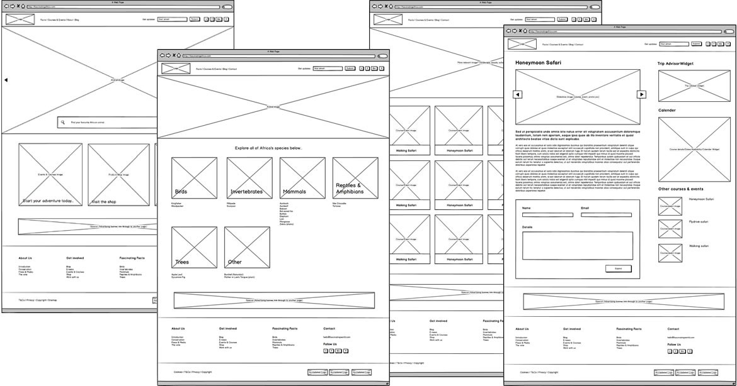
Activity #2: Wireframe

Slide 16
Exit Ticket

